Slide 1
CST-411
Introduction and Review

Slide 2

License and References
This work is licensed under a Creative Commons Attribution-NonCommercial-ShareAlike 4.0 International License
Fore more details: https://creativecommons.org/licenses/by-nc-sa/4.0/
The author is indebted to the generosity of others who have provided example problems and datasets. Where appropriate, external sources are cited both in the slides and in Jupyter Notebooks
My university offering of this course has an introductory Python course as a prerequisite
That course uses
Python Programming: An Introduction to Computer Science 2010, 3rd Edition, John Zelle, Franklin, Beedle & Associates Inc., ISBN 9781590282755
At times, example problems from that text will be cited

Slide 3
What is this course?
Computers are now ubiquitous in many domains and routinely used to help humans solve problems.
Scientific computing is the application of simulation, mathematical modeling, and numerical analysis in various scientific disciplines to gain additional insights and understanding of our natural world.
This course explores the field of scientific computing through the development of computer programs that model real-world problems in math, physics, and engineering.
This course helps you gain a theoretical understanding of when and how to apply scientific computing techniques while also gaining practical hands-on experience by applying these techniques to real-world problems.

Slide 4
Course Objectives
By the end of the course, it’s my goal to help students
Gain practical hands-on experience with scientific computing tools and software libraries through the analysis of real-world science and engineering problems
Gain a basic understanding of computational complexity and use it to describe which problems can, and cannot, be solved computationally
Understand algorithm design and demonstrate how a well written program can minimize the computational resources needed
Implement mathematical techniques in a computer program to explore real-world science problems
Compare and contrast scientific computing techniques to discuss their strengths and limitations

Slide 5
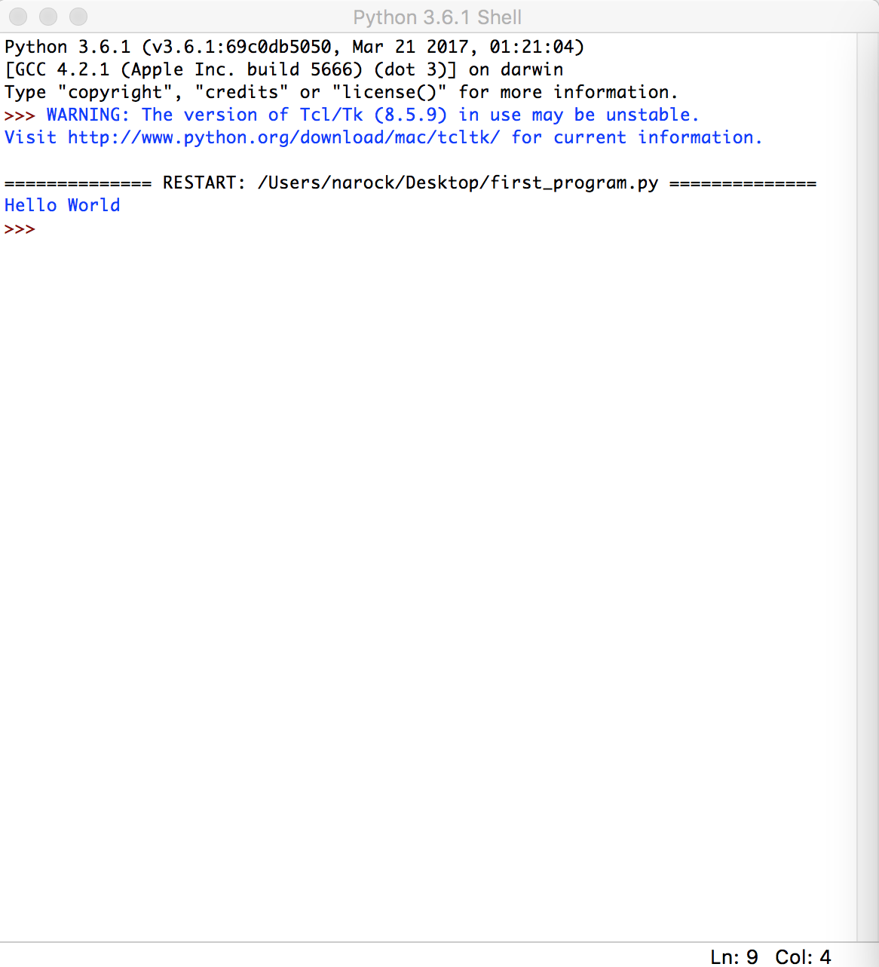
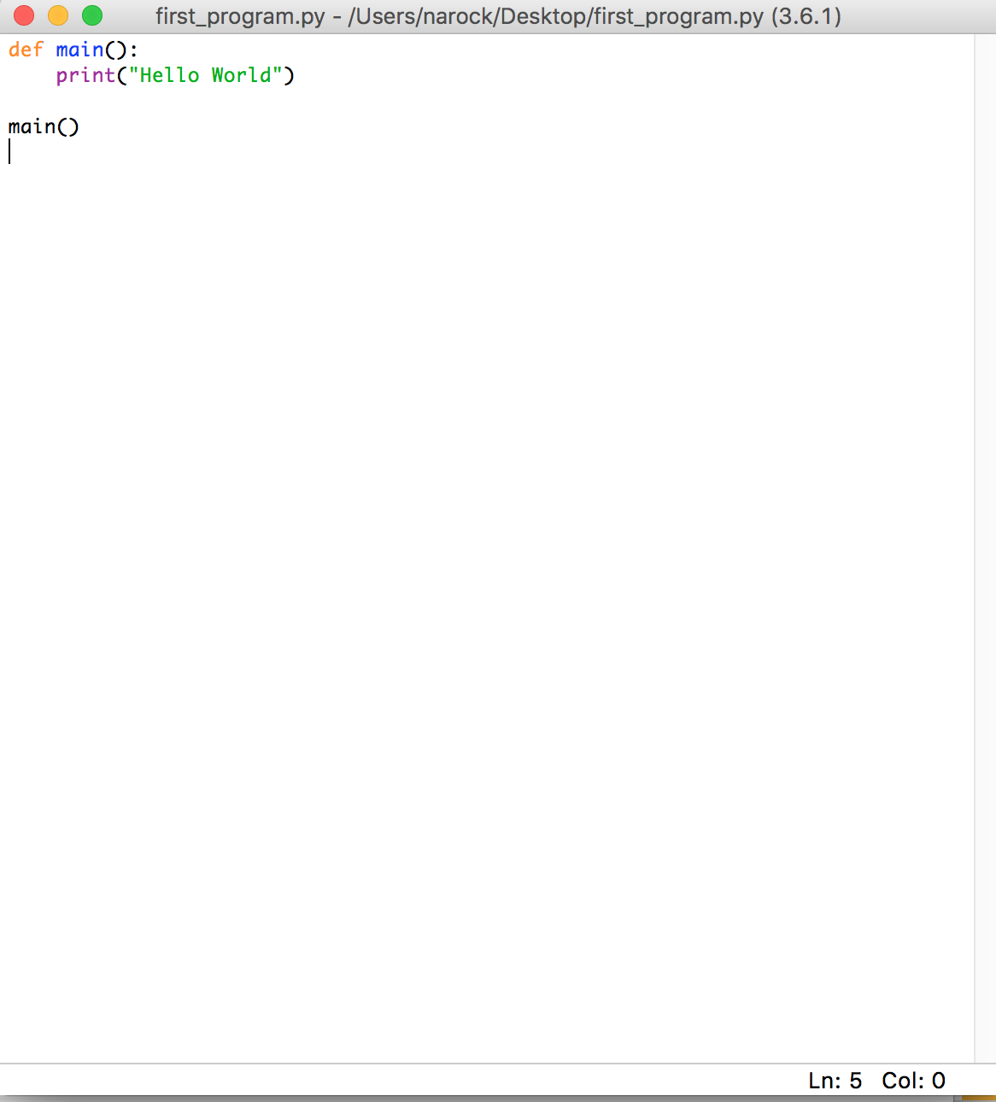
Jupyter Notebooks and hub
In CST-171 we used Python’s Integrated Development Environment (IDLE)
It’s possible to do scientific computing here, but…
We’re going to use several external libraries – ensuring that everyone has the proper installation and versions can be difficult
We often deal with large datasets that are difficult to move – it’s easier to move the coding to the data

Slide 6
Jupyter Notebooks and hub
We’re going to use a cloud-based computing environment for this course
Cloud-based is a term that refers to applications, services or resources made available to users on demand over the Internet from a shared server.
Specifically, we’ve been given access to the National Science Foundation’s JetStream cloud
JetStream is a national cloud computing infrastructure for science and engineering

Slide 7
Jupyter Notebooks and hub
JetStream is the shared server
The shared application we’ll be using is Jupyter Hub
Jupyter Hub is the next iteration of iPython
A web-based shared programming environment
We’ll be creating Jupyter Notebooks, which are a collection of code, comments, and documentation
Jupyter Hub is the application that allow us to create/share/reuse Jupyter Notebooks – think Google Docs (Hub) and shared documents (Notebook)
Image credit: http://jupyter.org/

Slide 8
Jupyter Notebooks and hub
Let’s test our Jupyter Hub logins
https://js-16-130.jetstream-cloud.org/
Overview of Jupyter Hub
Creating a new notebook
Uploading/Downloading
Cells – creating, executing, moving
Markdown
Image credit: http://jupyter.org/

Slide 9
Example problem
Let’s dive right in and review our Python by solving a physics problem
This example is from Zelle, Chapter 10, page 156
Suppose we want to write a program that simulates the flight of a cannonball (could be any projectile such as a baseball). We want to find out how far the cannonball will travel when fired at various launch angles and initial velocities.
The input to the program will be the
launch angle (in degrees)
the initial velocity (in meters per second)
and the initial height (in meters)

Slide 10
Example problem
The output will be
the distance that the projectile travels before striking the ground (in meters).
We’ll ignore the effects of wind resistance
However, the acceleration of gravity near the earth’s surface is about 9.8 meters per second per second and can’t be ignored
This highlights important points about scientific computing.
Computer programs are often approximations of the real-world
What we’re going to do with the results dictate what we can safely ignore (wind resistance)
Be careful not to simplify the problem too much or the results won’t be realistic (gravity)

Slide 11
Example problem
Let’s start by designing an algorithm for this problem.
We’ll consider the flight of the cannonball in two dimensions:
height, so we know when it hits the ground,
and distance, to keep track of how far it goes.
We can think of the position of the cannonball as a point (x, y) on a 2-dimensional graph
The value of y gives the height and the value of x gives the distance from the starting point
We’ll need to update the position of the cannonball to account for it flying through the air
For simplicity, let’s say the cannon ball starts at (0,0) and we want to check its position every tenth of a second. In that interval, it will have moved some distance in height (y) and some distance horizontally (x).
This is our first introduction to complexity
Updating the location on short intervals gives us more precise results
It also adds more computations to our program
This can lead to programs that take so long to execute they are essentially useless (we’ll revisit this later)

Slide 12
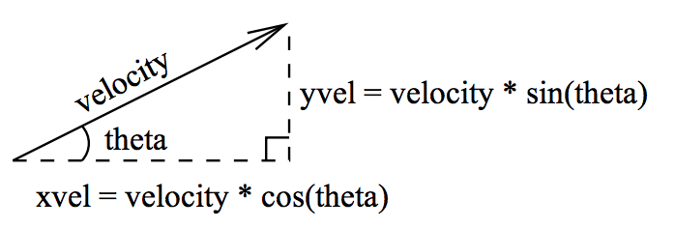
Example problem
The distance in each dimension is determined by its velocity in that direction
Since we are ignoring wind resistance, the x velocity remains constant for the entire flight of the cannon ball
However, the y velocity changes over time due to the influence of gravity
The cannon ball will have a y velocity at the start of our time interval and another y velocity at the end of our time interval. We’ll take an average
Image from Zelle. Figure 10-1, page 157

Slide 13
Example problem
This gives us the following algorithm
Input the simulation parameters: angle, velocity, height, interval
Calculate the initial position of the cannon ball: xpos, ypos
Calculate the initial velocities of the cannon ball: xvel, yvel
While the cannon ball is still flying: update the values of xpos, ypos, and yvel
Output the distance traveled
Image from Zelle. Figure 10-1, page 157

Slide 14
Example problem
Let’s look at each of these in turn and try to implement in a Jupyter Notebook
Input the simulation parameters: angle, velocity, height, interval
Which Python construct can we use to get these values from the user of our Notebook?
Image from Zelle. Figure 10-1, page 157

Slide 15
Example problem
Let’s look at each of these in turn and try to implement in a Jupyter Notebook
Calculate the initial position of the cannon ball: xpos, ypos
Let’s create two Python variables xpos and ypos to hold the position of the cannon ball
We’re starting at the origin so xpos = 0
ypos is the starting height of the cannon ball, which we received as input in step 1.)
Image from Zelle. Figure 10-1, page 157

Slide 16
Example problem
Let’s look at each of these in turn and try to implement in a Jupyter Notebook
Calculate the initial velocities of the cannon ball: xvel, yvel
To do this, we need to work with the angle
Important note: our input data won’t always match how Python works with data
theta = math.pi * angle / 180.0
xvel = velocity * math.cos(theta)
yvel = velocity * math.sin(theta)
Image from Zelle. Figure 10-1, page 157

Slide 17
Example problem
Let’s look at each of these in turn and try to implement in a Jupyter Notebook
While the cannon ball is still flying: update the values of xpos, ypos, and yvel
How do we ask Python to continually do something?
What is our stopping condition?
We have velocity in m/s and a time step of 0.1 seconds
Multiplying the two will get us to meters traveled and a new position
Image from Zelle. Figure 10-1, page 157

Slide 18
Example problem
Let’s look at each of these in turn and try to implement in a Jupyter Notebook
While the cannon ball is still flying: update the values of xpos, ypos, and yvel
while ypos > 0:
xpos = xpos + time * xvel
yvel1 = yvel - time * 9.8
ypos = ypos + time * (yvel + yvel1)/2.0
yvel = yvel1
Image from Zelle. Figure 10-1, page 157

Slide 19
Example problem
Let’s look at each of these in turn and try to implement in a Jupyter Notebook
How far did the cannon ball travel?
# this is just a print statement
print("Distance traveled:", xpos, "meters")
# or we could do a little formatting
print ("Distance traveled: %0.1f meters." % (xpos))

Slide 20
Example problem
How far will the cannon ball travel with inputs of
Angle: 40 degrees
Velocity: 25 m/s
Height: 2 meters
Interval: 0.1 seconds
Solution is in Jupyter Notebook 01_CannonBall.ipynb

Slide 21
Software bugs
You’re program may not have worked perfectly the first time
A software bug is an error, flaw, failure or fault in a computer program or system that causes it to produce an incorrect or unexpected result, or to behave in unintended ways. The process of fixing bugs is termed ”debugging"
Wikipedia https://en.wikipedia.org/wiki/Software_bug
Thomas Edison was the first to use the term bug in a technical sense. In the 1800’s, while working on the light bulb, he mentioned the invention had an “Awful lot of bugs still”
Years later, the term was applied to errors in software
There are 3 types of errors in computer software

Slide 22
Software bugs
1.) Syntax Error
Programming languages have well-defined syntax
A syntax error occurs when we misuse the syntax via spelling or capitalization
Example in Python
Using forrr instead of for in a loop
Using myvariable when then name is actually myVariable
These are the easiest to find and fix
Tools (IDLE and Jupyter) often catch and highlight these for us
Your program won’t run until their all fixed

Slide 23
Software bugs
2.) Run-Time Error
Certain combinations cause the program to crash
Example in Python
x = float(input(“Enter a value”))
y = float(input(“Enter a value”))
z = x / y
This will work fine, except when y is 0

Slide 24
Software bugs
3.) Logical Error
We implement a formula/equation incorrectly
We get results and no error messages – but, our results our not correct
Example in Python
area_of_circle = math.pi * radius
These are the most difficult and time consuming to find and fix

Slide 25
Python’s Assert statement
Python's assert statement helps us find bugs more quickly.
When you code, you often have implicit ideas in your head about how the program should operate and the values of variables at certain points.
Assertions are a way to check that the internal state of a program is as you expect
Assertions make your implicit assumptions explicit and are good for quickly catching false assumptions that were made while writing the code,
Example in Python
x = 10
y = 10
assert x == y
print(x)

Slide 26
Python’s Assert statement
Example in Python
x = 10
y = 10
assert x == y
print(x)
Here, we’re asserting that we expect x to be equal to y
If it is, Python happily continues on
If it’s not, Python stops at this line and tells us the assertion is false

Slide 27
Python’s Assert statement
Types of assertions
Comparison of values, can use >, <, >=, <=, ==
assert x > 10
Checking the type of data
# we have a variable id and want to make sure it’s stored as an integer
assert type(id) is int
# we have a variable name and want to make sure it’s stored as a string
assert type(name) is str
Checking for known “can’t happen” situation
# we’re creating a program in which all elements of the list must be unique
assert new_value not in myList

Slide 28
Python’s Assert statement
Assert statements will not everything and will not completely remove bugs
In fact, they can be turned off in Python
Yet, selectively using assert throughout your programs can save you a lot of debugging time

Slide 29
Python Data Collections
In scientific computing we often deal with datasets having multiple values
Two ways to represent multi-valued data in Python are
Lists
Dictionaries
A list is created with square brackets
x = [5, 4, 3, 2, 1]
x = [5, 4, “yes”, 1.25, “no”] # lists can contain different types of data

Slide 30
Python Data Collections
Recall that Python starts counting at zero
x = [5, 4, 3, 2, 1]
x[0] # the first value in our list, 5
x[-1] # short-hand way of asking for the last element
Loops can be helpful in iterating over all the values of a list
for currentValue in x:
print(currentValue)
Don’t forget to indent the contents of the loop
currentValue is what we want to call our current position in the loop – you can name this variable whatever you like

Slide 31
Python Data Collections
A dictionary is a collection of key-value pairs and is created with curly brackets
x={'alice':1234, 'bob':'someText’}
Dictionaries are very useful for data that comes in pairs, such as
Usernames/passwords
Addresses/zip codes
Person/social security number
Person/birth day
Things to note
The keys and values can be a mix of data types
Indexing with the key gets you the value, x[‘alice’] will return 1234
Dictionaries can be extended at any time, just define a new key/value, such as x[‘susan’]=456
You can create an empty dictionary and fill in its values later, x = {}

Slide 32
Python Data Collections
x={'alice':1234, 'bob':'someText’}
Accessing what’s inside a dictionary
Getting just the keys
for key in x.keys():
Getting just the values
for value in x.values():
Getting both keys and values
for key, value in x.items():

Slide 33
Word frequency
Let’s practice and review Python data collections through a real problem
Peter Norvig, an AI researcher, has created a large text file for public analysis
https://norvig.com/big.txt
We’re going to
Download this file
Upload it to Jupyter Hub
Create a notebook that reads the file and counts how many times each word appears
First, a quick review of file reading in Python…

Slide 34
Word frequency
The open command opens a text file
infile = open("big.txt", "r")
We use “r” when reading and “w” when writing
We can then pass this variable to a loop to iterate over all the lines in the file
for line in infile:

Slide 35
Word frequency
Some things that will be helpful here
# convert all letters to lower case
# this way "the" matches "The"
line = line.lower()
# replace each punctuation character with a space
# this way “the.” matches “the” matches “the!”
for ch in '!"#$%&()*+,-./:;<=>?@[\\]ˆ_‘{|}˜’:
line = line.replace(ch, ' ‘)
We want to implement the algorithm
Create an empty dictionary
Get the next word in the file
If we have not seen this word then the key is the word and the value is 1
If we have seen this word then update the value to be value+1

Slide 36
Word frequency
What is the most frequent word?
What is the least frequent word? Solution is in 02_WordFrequency.ipynb
One caveat here, dictionaries are not sorted in any way
Python does have a sort function, but it’ll sort the keys not the values
That won’t work here as it’ll just put the words in alphabetical order
We need to reverse the order – keys become values and values become keys and then sort
for (key,value) in frequency.items()) # loops over the keys/values
sorted() # Python sorting function
We can combine this into one Python statement
sorted_d = sorted((value, key) for (key,value) in frequency.items())

